Slide 1


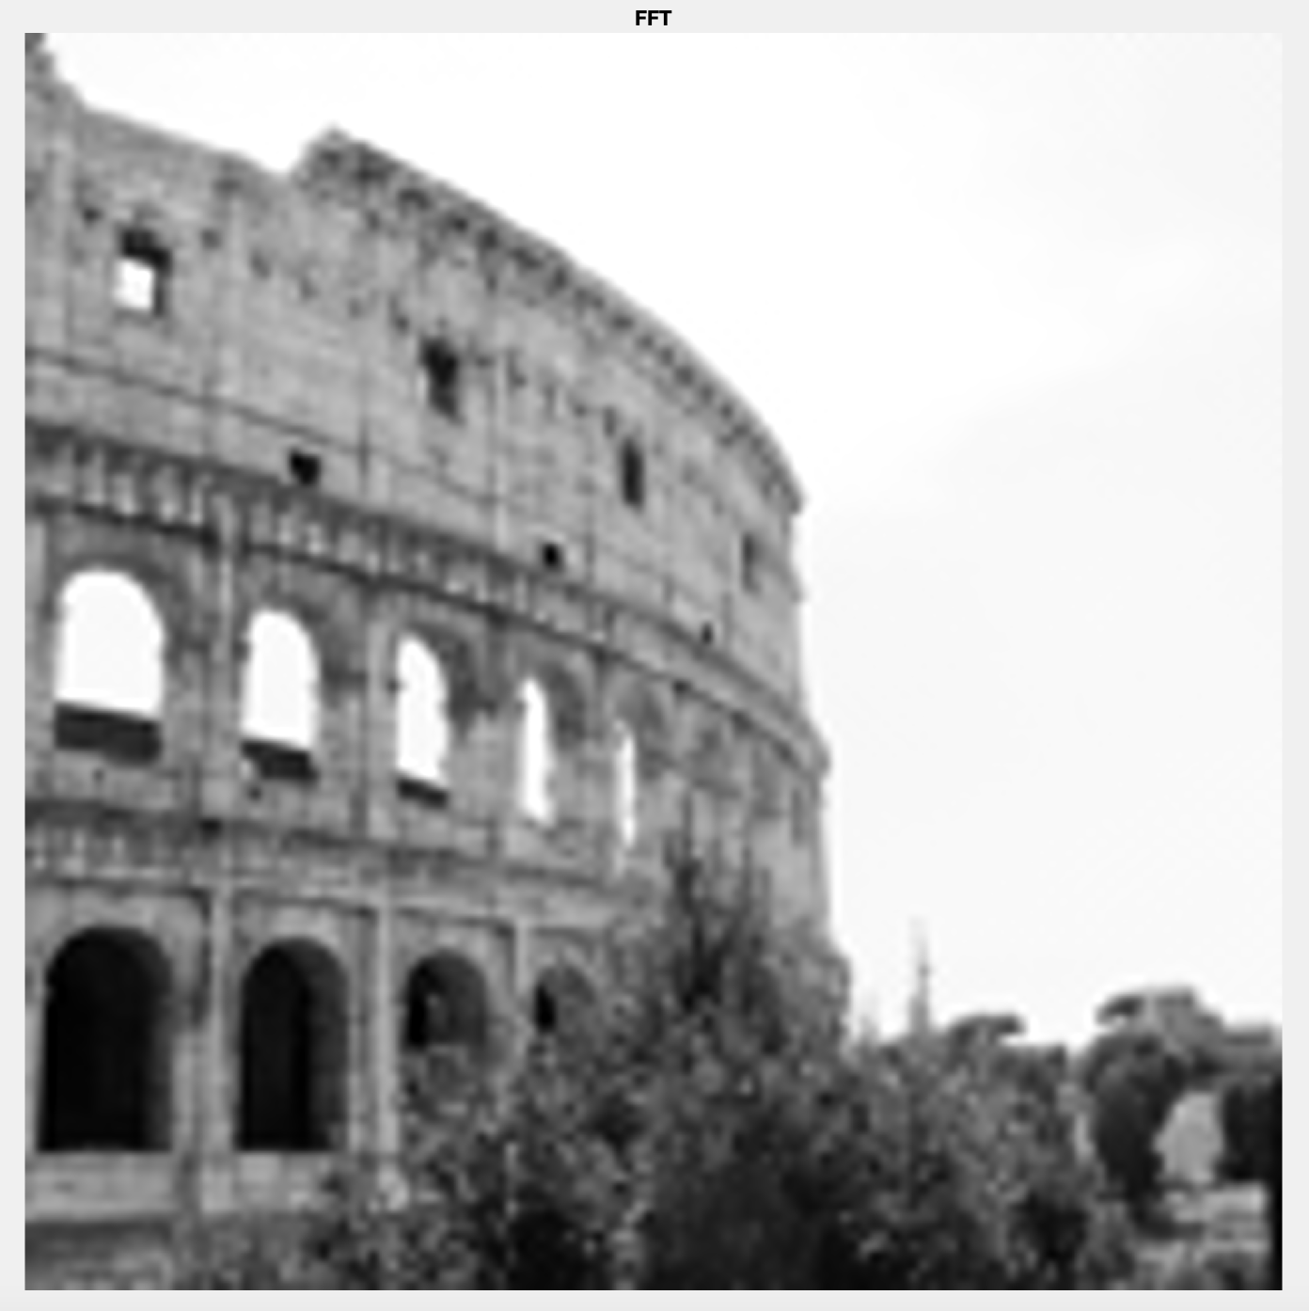
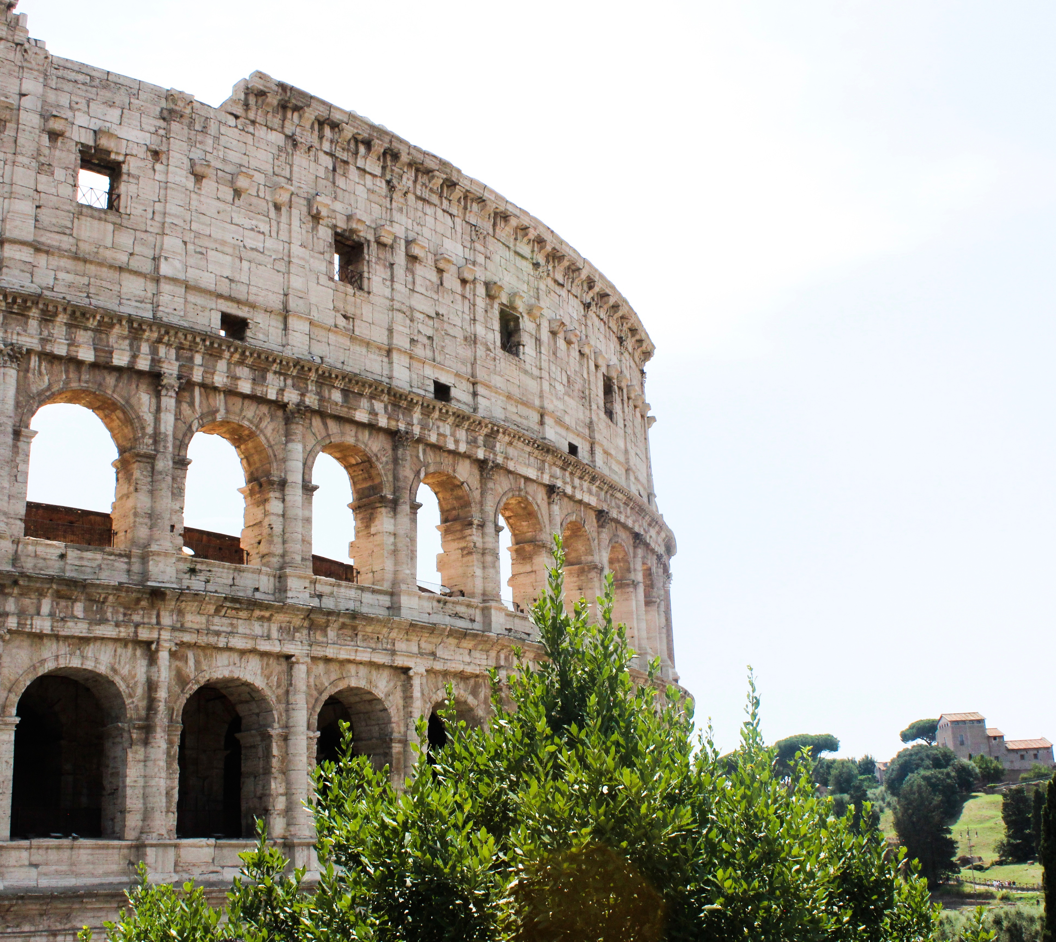
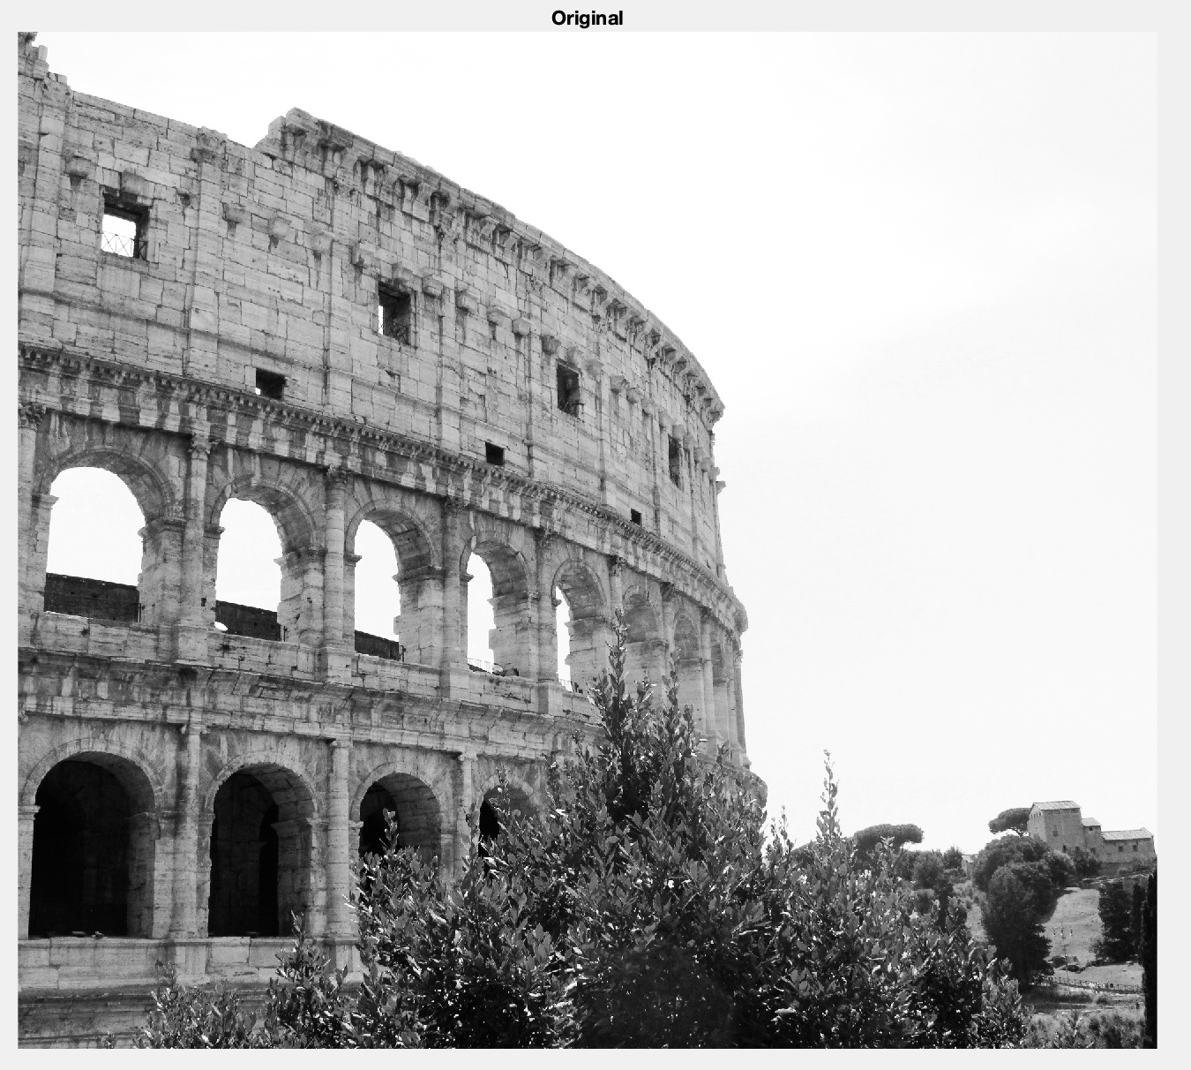
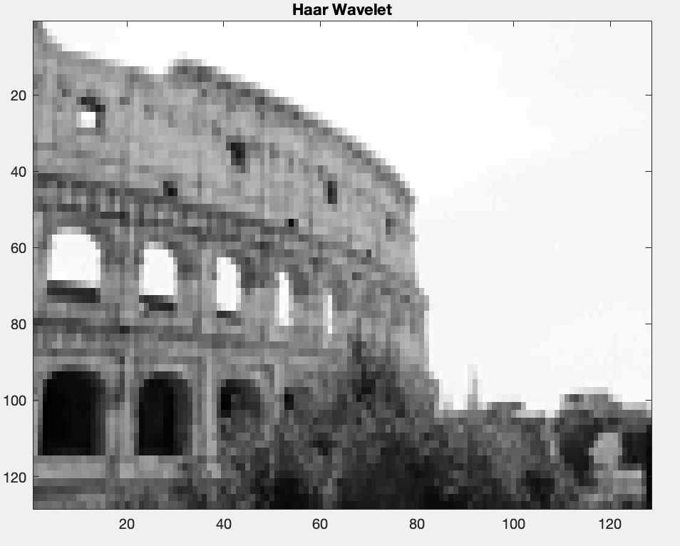
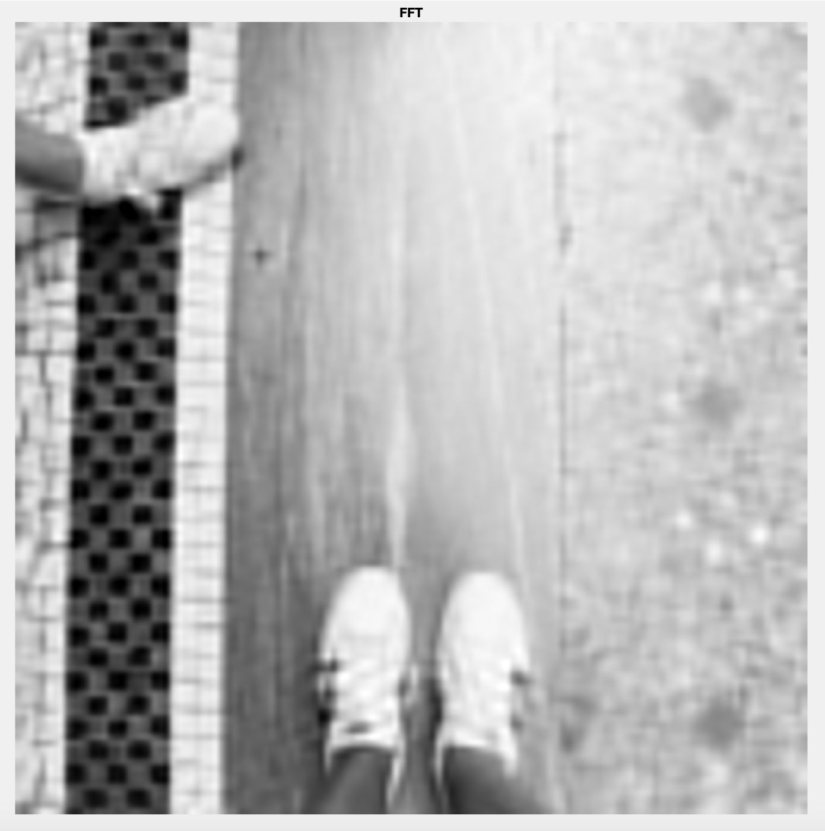

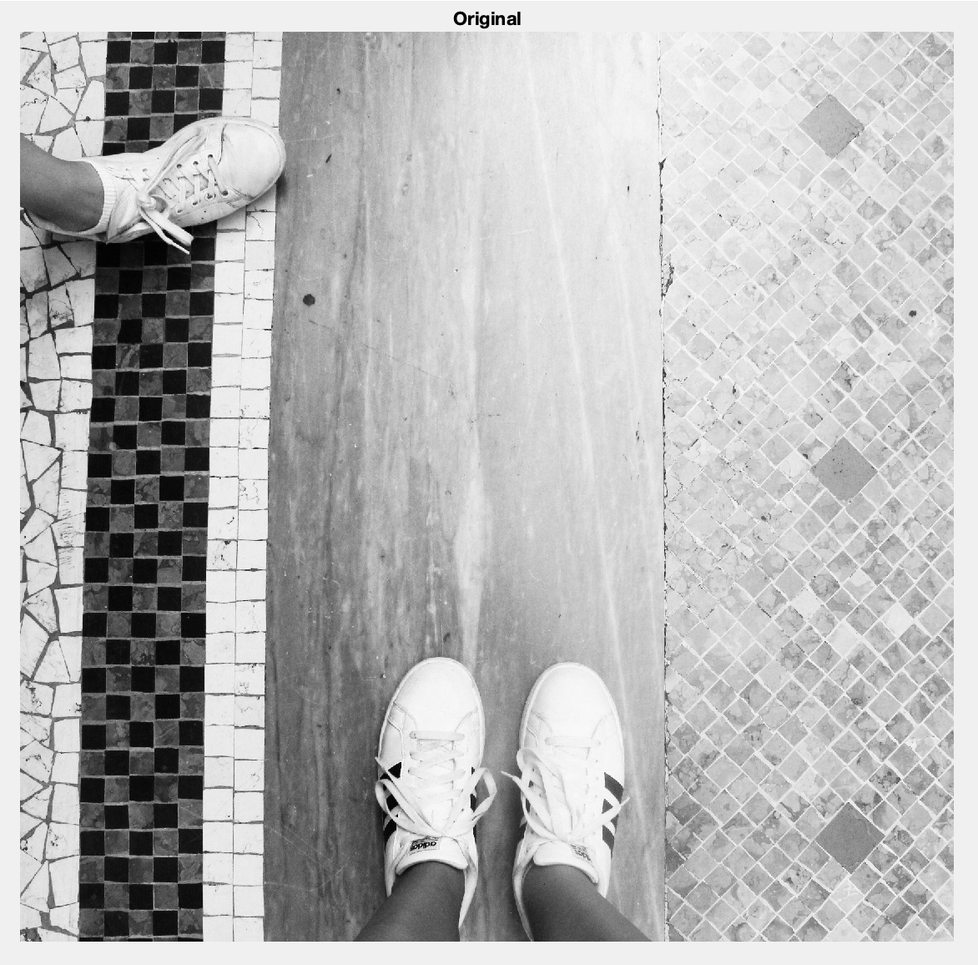
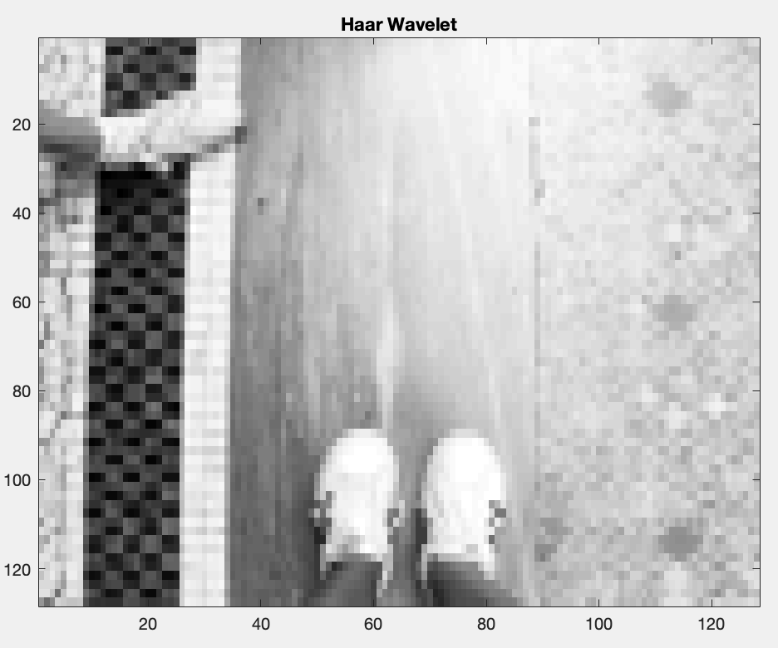
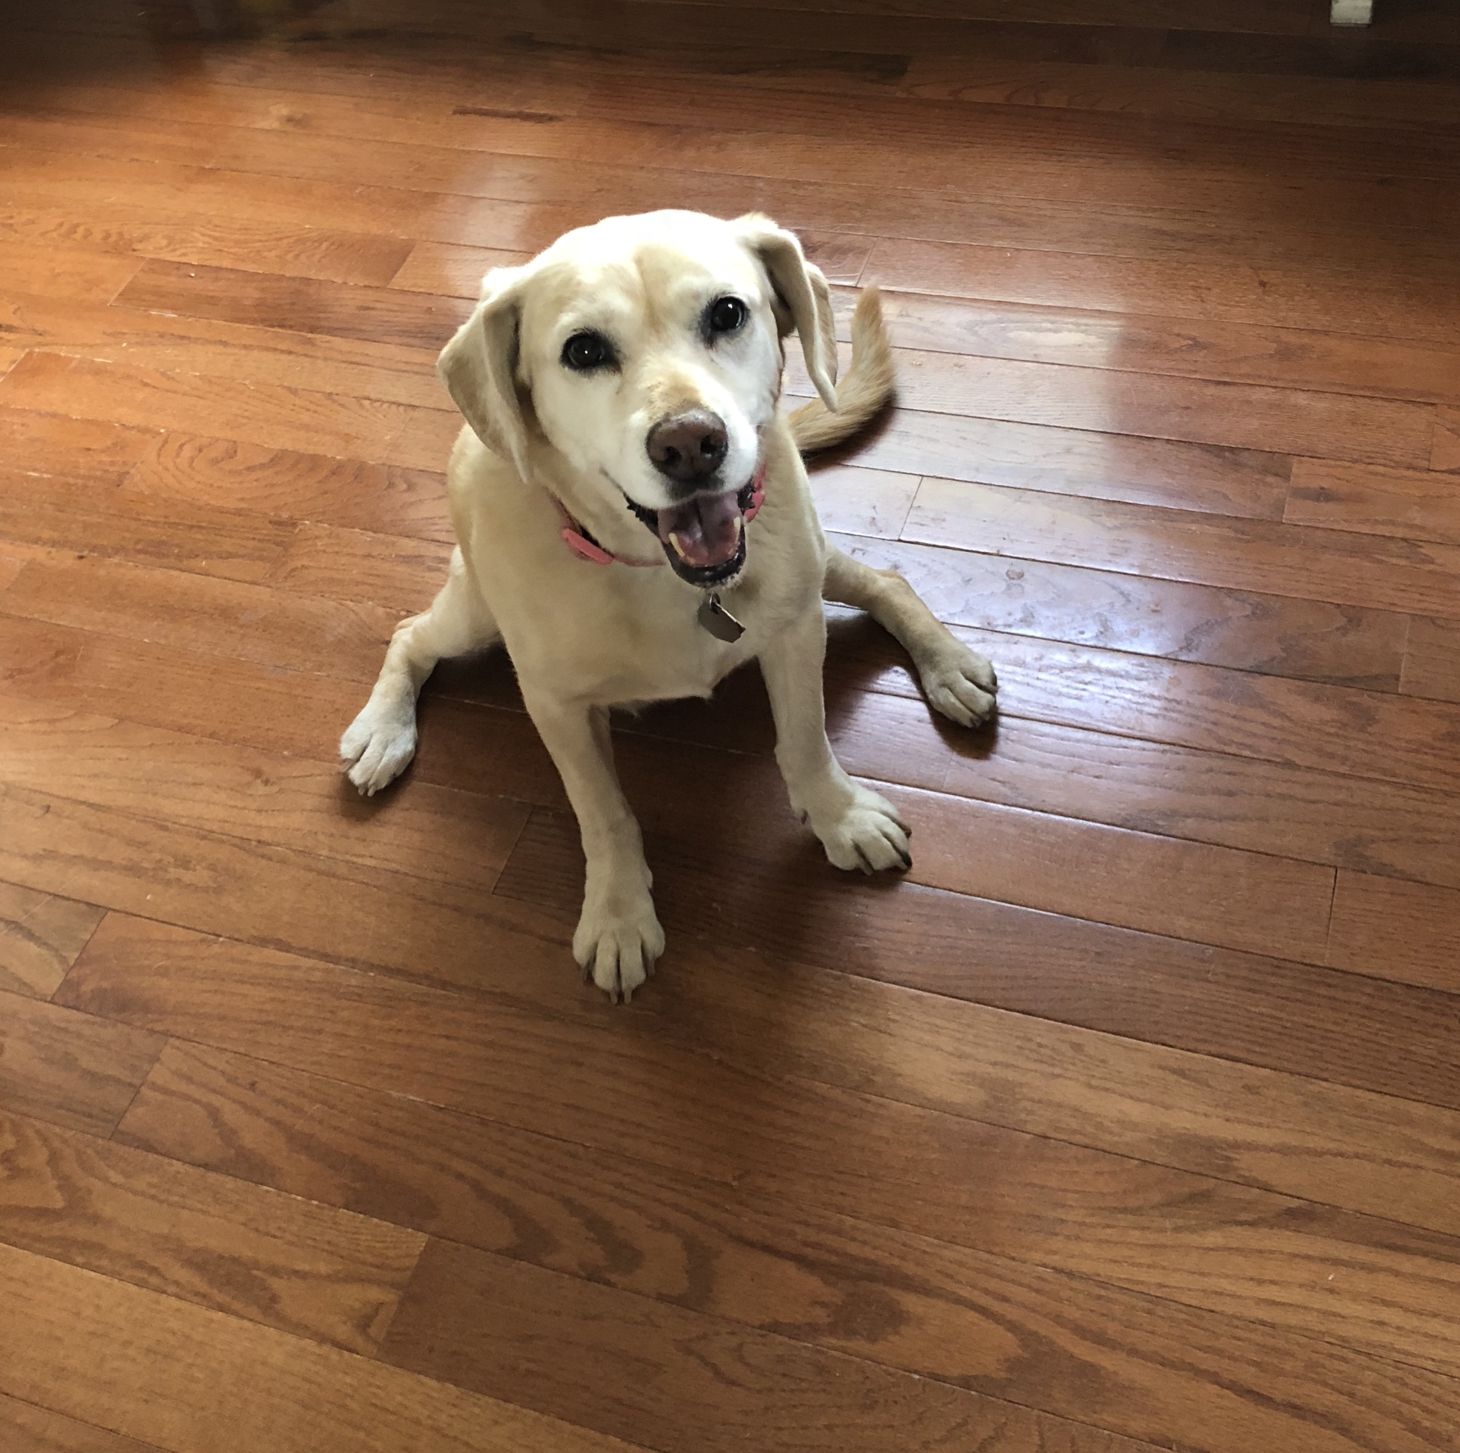
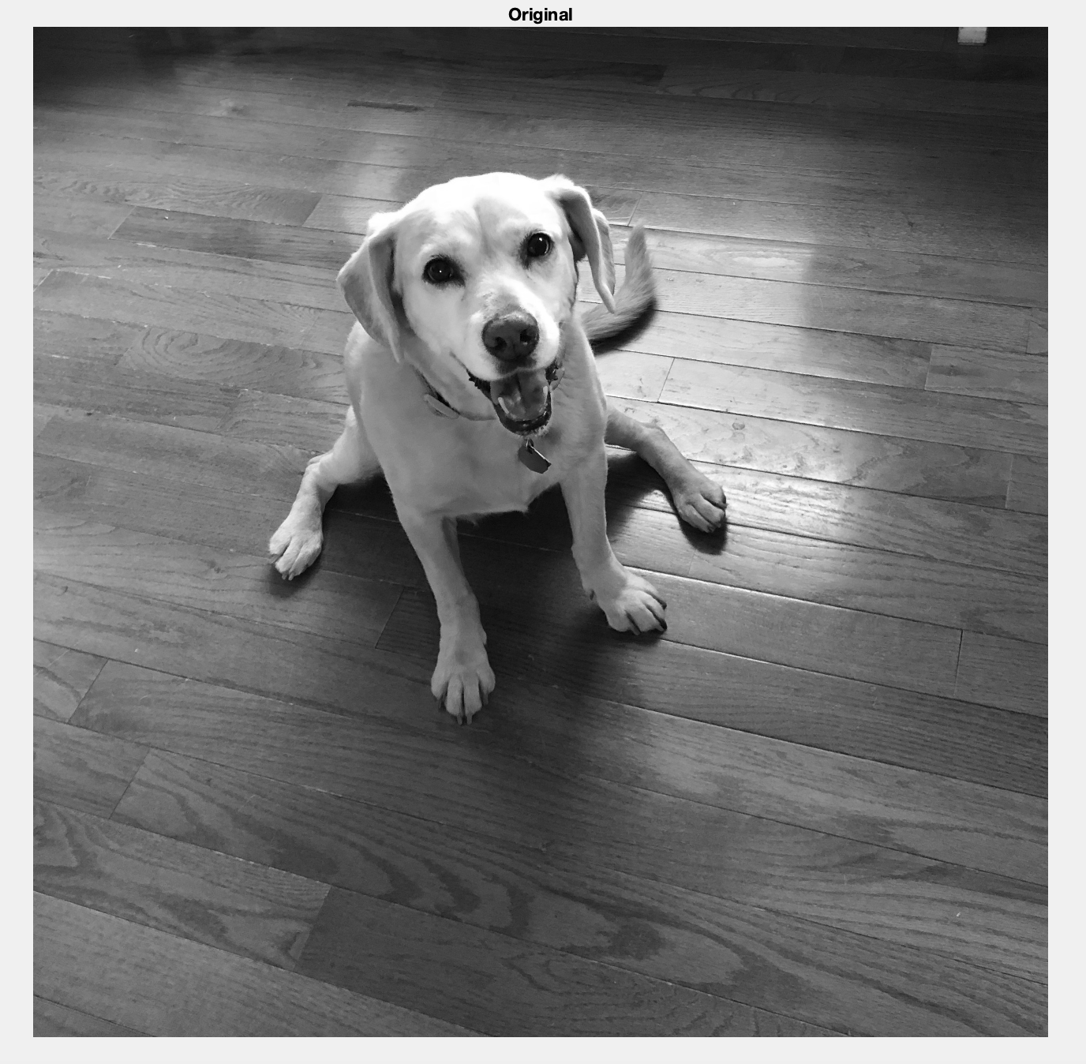
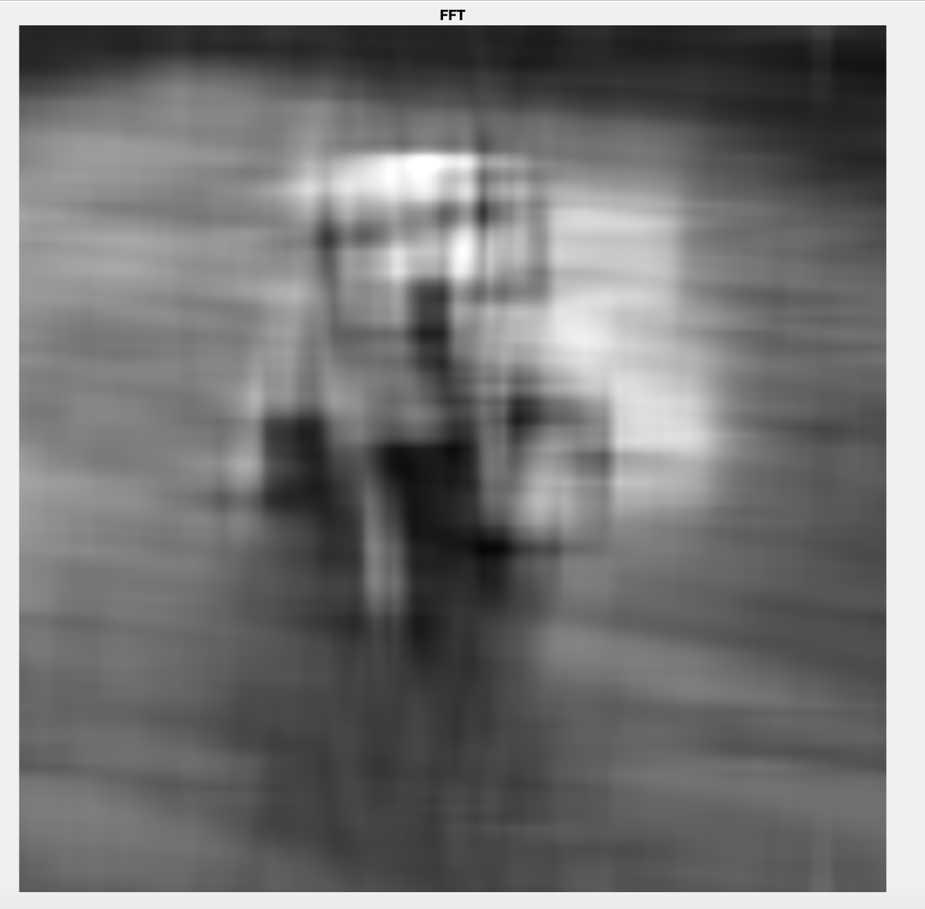
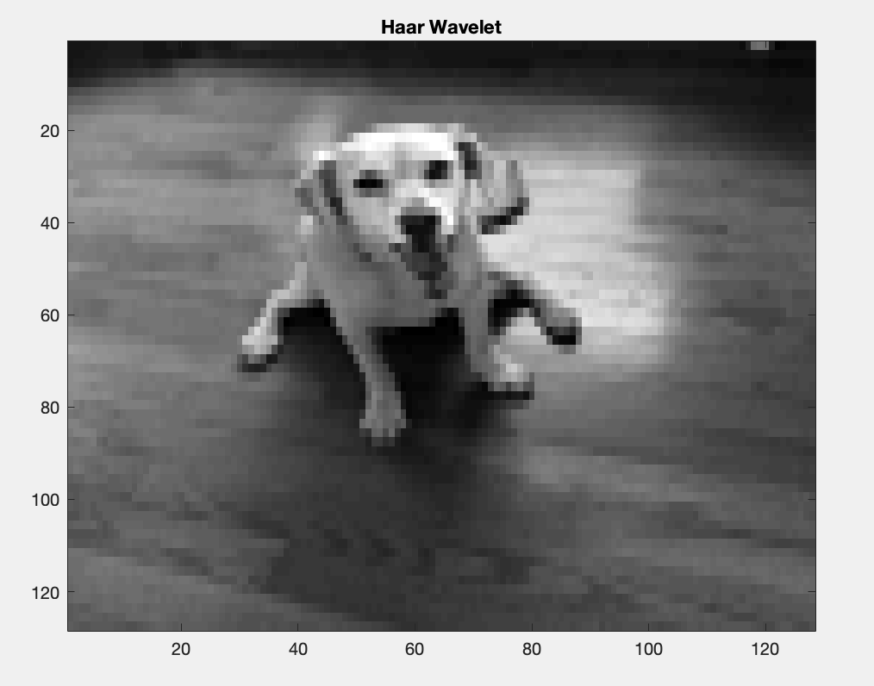
Image Reconstruction
Fast Fourier Transform
(Removing high frequency coefficients)
Grey scale representation of the original photograph
Haar Wavelet Transform
(Removing detail coefficients)
Fast Fourier Transform
(Removing more high frequency coefficients)
Grey scale representation of the original photograph
Haar Wavelet Transform
(Removing detail coefficients)
Fast Fourier Transform
(Removing more high frequency coefficients)
Grey scale representation of the original photograph
Haar Wavelet Transform
(Removing detail coefficients)

